Slide 1
Vigenere Cipher
Gnana Prasanna-2003A51136
Meghana-2003A51133

Slide 2
What we learnt from the course project
We were able to identify classes, objects, members of a class and relationships among them and used them for desired problems.
We could demonstrate the concepts we learned in lectures in real time through the project.
We have illustrated Java programming skills and implemented in our code.
We have realised difference between multithreaded programming with ordinary programming tools and models.
We could build a GUI interface using collections.

Slide 3
Problems we faced while implementing
We faced some difficulties while adding the GUI to the code of the cipher.
There were some complexities and errors in implementing the interface concept.

Slide 4
Solution
We have referred through the basic concepts and examples of the topics where we faced issues and tackled them accordingly.
We have discussed with peers and received their help to obtain the optimal solution for the problem faced.
We have used objects ,classes ,methods ,constructor ,access specifiers ,overriding ,overloading ,exception handling ,swings.

Slide 5
Introduction
The vigenere cipher is an algorithm that’s used to encrypt and decrypt a text or message. It’s an algorithm of encrypting an alphabetic text that uses a series of interwoven Ceaser ciphers. It is based on the keyboard’s letters.It is an example of polyalphabetic substitution cipher. It’s an easy to understand and implement Algorithm.
It was first described in 1553 by Giovan Battista Bellaso.
We use a Vigenere table or Vigenere square for encryption and decryption of the text.

Slide 6
Objective
Ciphers are used to provide encryption, authentication, and data integrity checks in real time.
So the main objective of our course project is to implement this in real time using the knowledge provided .

Slide 7
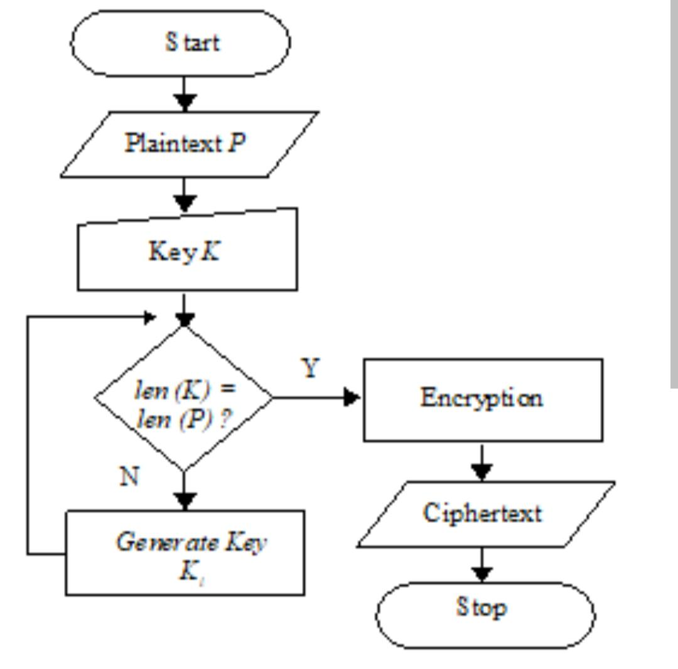
Procedure/Flowchart

Slide 8
Reason for choosing the project
The strength of the Vigenère cipher is that it is not susceptible to frequency analysis due to the fact that the cipher rotates through different shifts, So the same plaintext letter will not always be encrypted to the same ciphertext.
The cipher disguises plaintext letter frequency like most other polyalphabetic substitution ciphers the main idea was to create a cipher that will disguise letter frequency which greatly interfered frequency analysis methods.
These qualities makes it unique from others and provides security unapologetically.

Slide 9
Reference
https://in.docworkspace.com/d/sIKex3pJdwrfcmwY?sa=e1&st=0t
Notes provided by the faculty of java and cryptography.

Slide 10
Conclusion
By the end of the project we have accomplished the purpose of a vigenere cipher.
We were able to encrypt and decrypt a plaintext that will be provided dynamically by the end user.
We have been able to ensure the security of the vigenere cipher using the concept and knowledge which had been provided to us by the lecturer.

Slide 11
Acknowledgement & Thanksgiving
We would like to express our thanks of gratitude to our professor T. Sampath Kumar sir who gave us the opportunity to do this wonderful project on the topic of Vigenere Cipher which helped us in conducting a proper research and deep learning on the concepts of Java.
Secondly we would like to thank our peers who reviewed and rectified any issues that were overlooked while finishing the course project.

